Slide 1
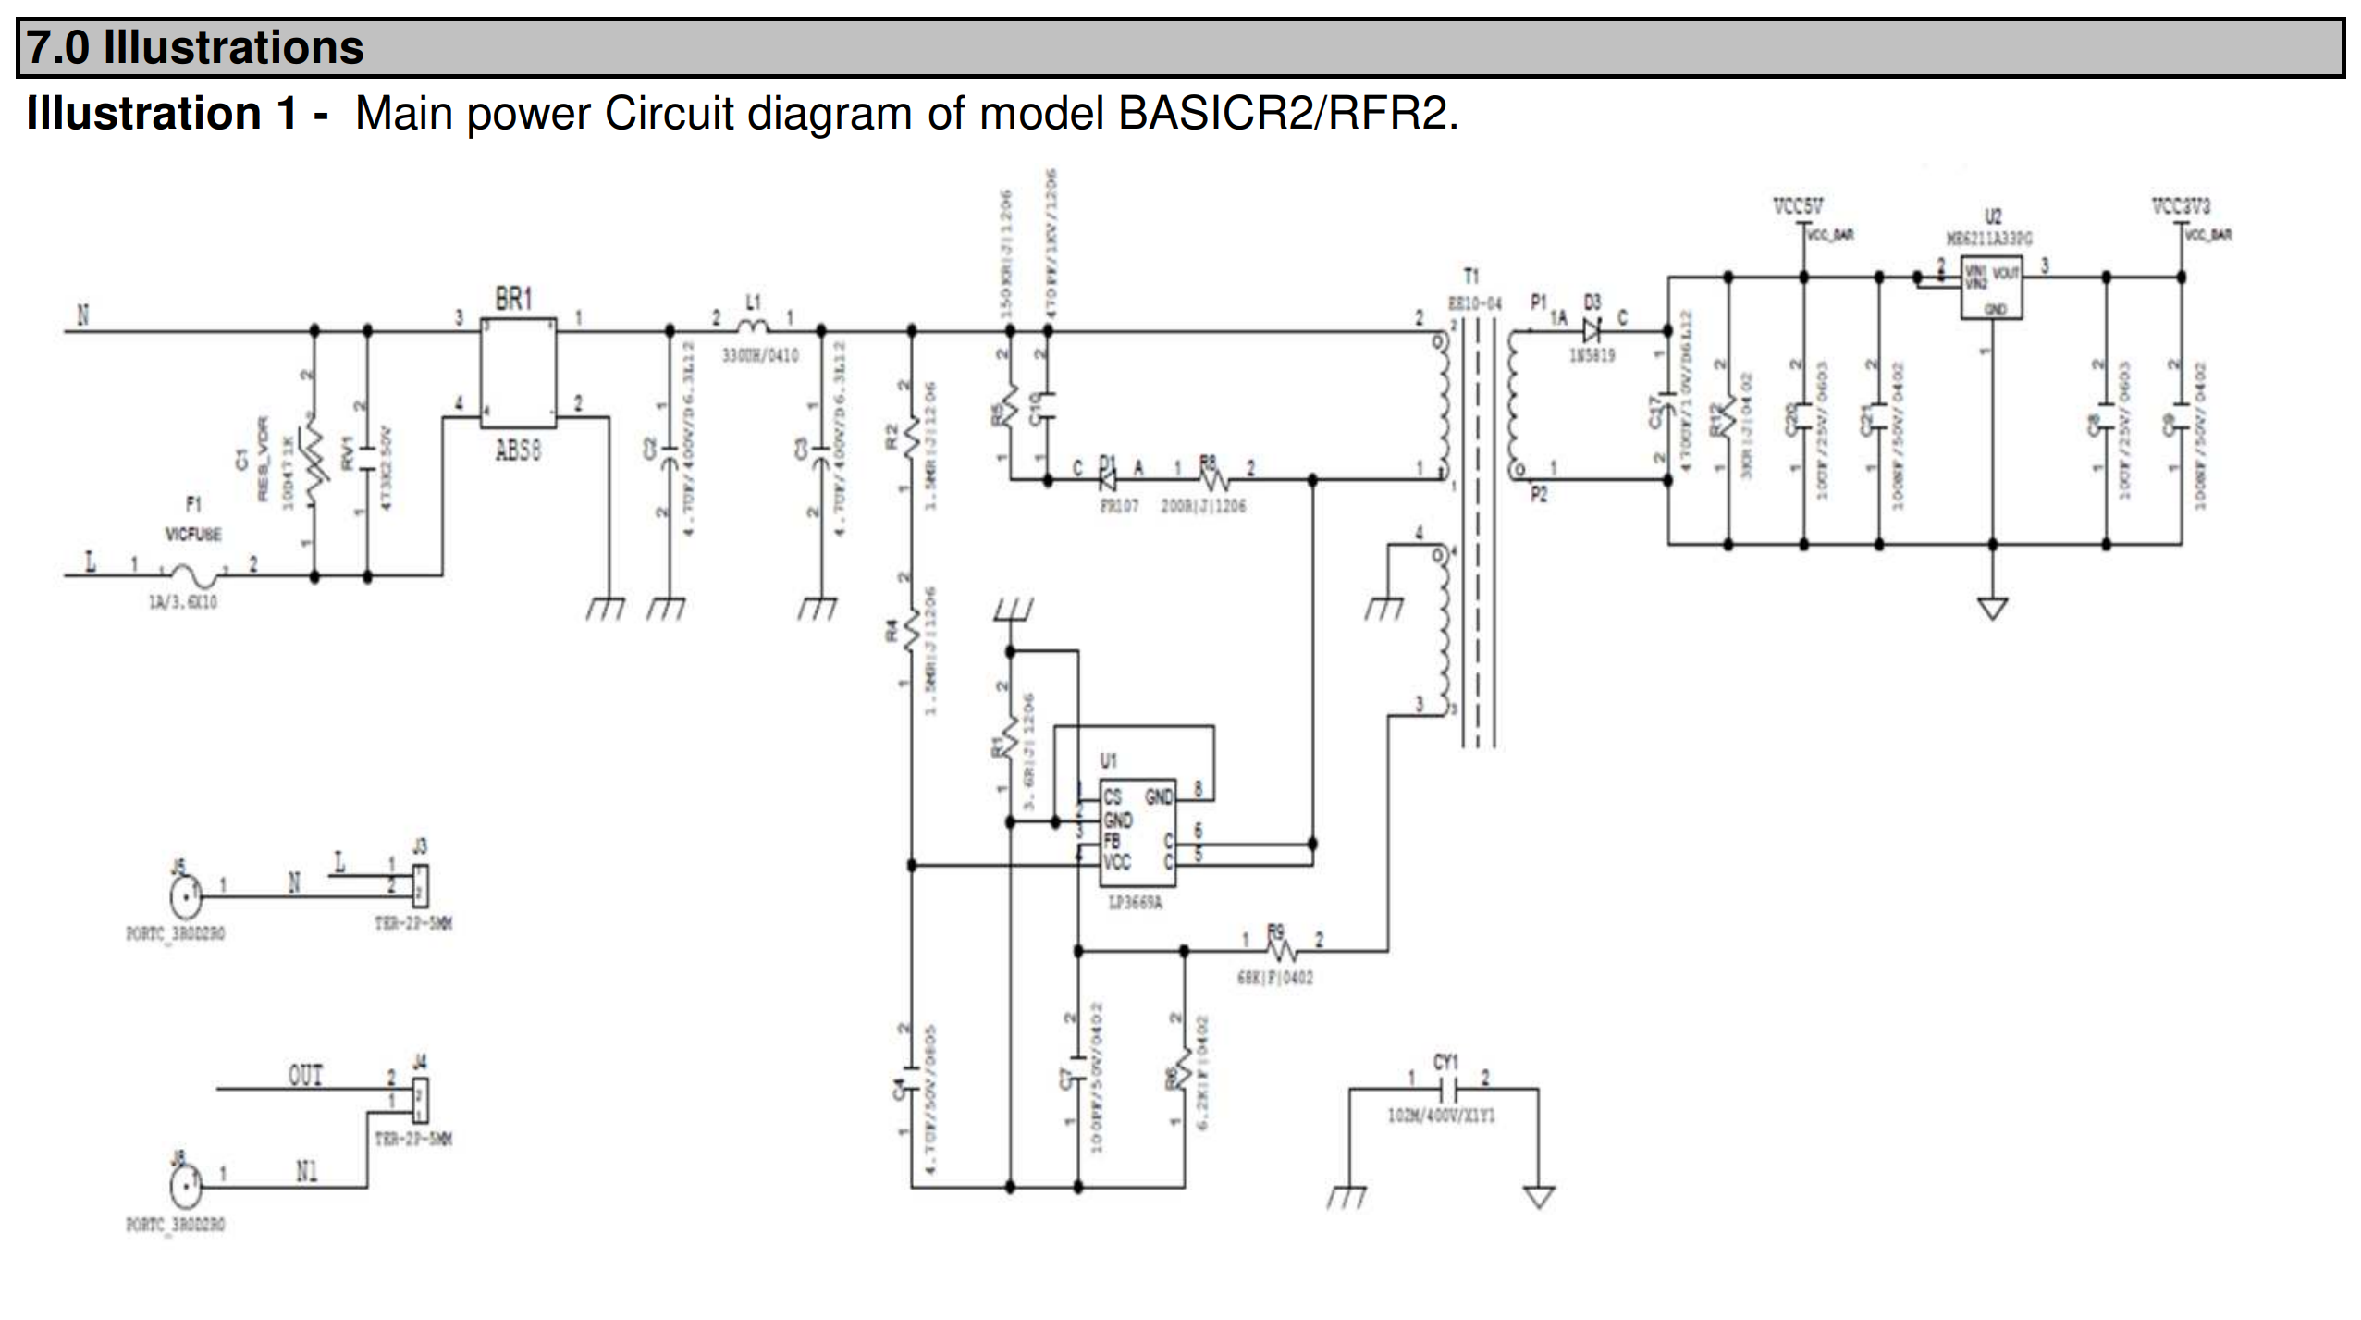
Modified Circuit for using with 12V DC Supply.
Remove L1
Remove D3
7805
12V In
5V Out
-
12V
+
Common
WARNING:
Making modifications to original
manufacturers device will invalidate
your warranty.
You undertake this modification at your
Own Risk

